Slide 1
R Basics
March 15, 2018

Slide 2
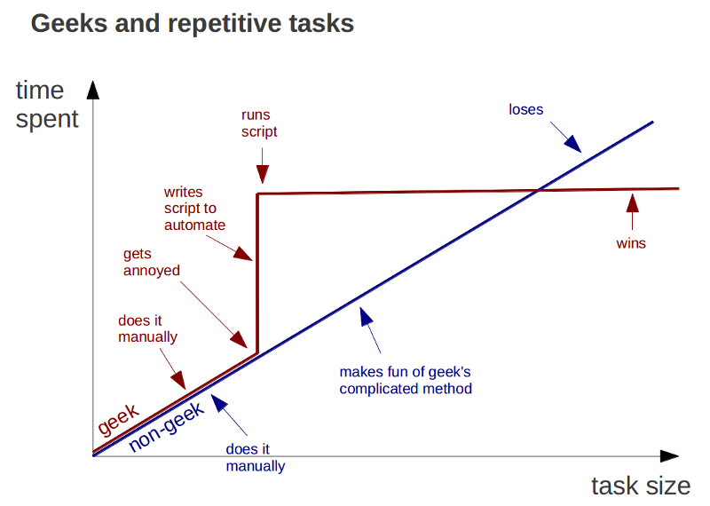
When to use programming
Source

Slide 3
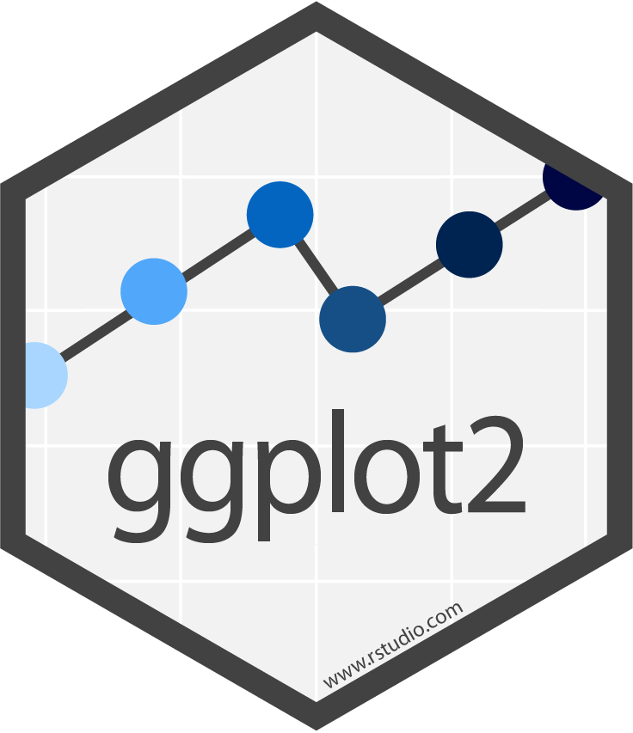

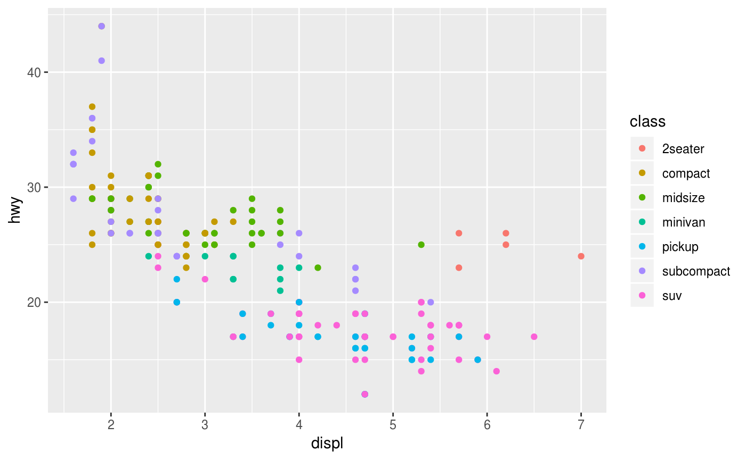
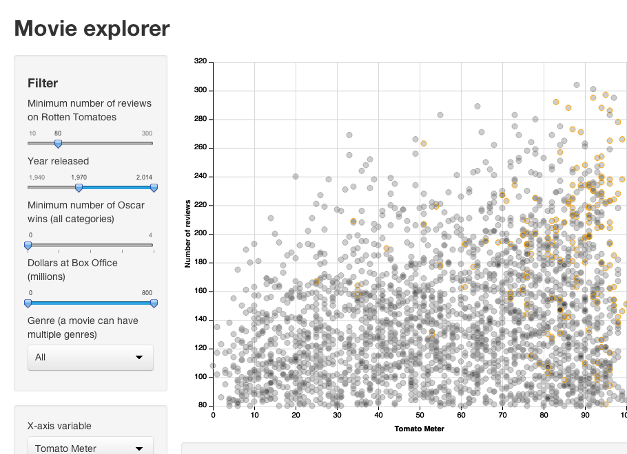
Where R can take you
Visualizations
Interactive dashboards
Generate graphs dynamically as data changes. Control every aspect, and layer elements as needed.
Confused about how Tableau and PowerBI arrive at numbers? Control every calculation! Spend forever formatting? Control every aspect of how the dashboard looks!

Slide 4


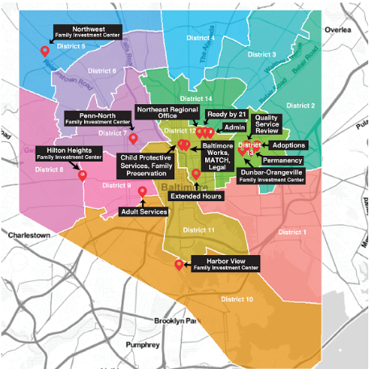
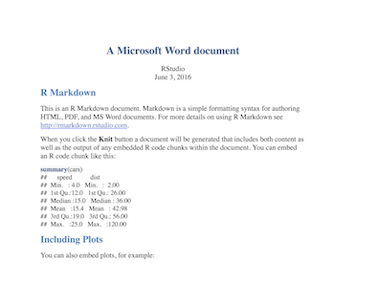
Where R can take you
Dynamic Reports
ggmap
Maps
Create PDFs, presentations, Word documents, notebooks, websites, etc. with dynamically generated numbers and figures. Never copy and paste again!
Easier to manipulate data prior to mapping and at least 3x more attractive than ArcGIS!

Slide 5
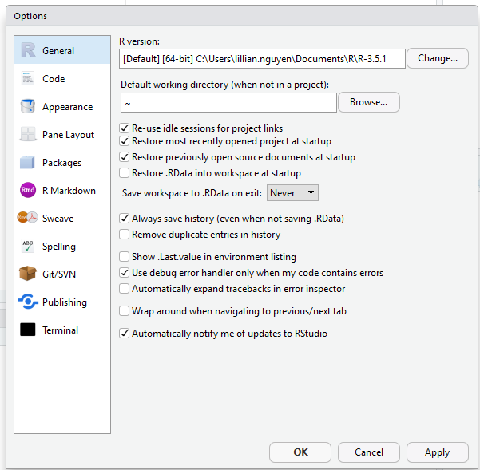
A change of approach
You should be willing to ‘throw away’ your outputs.
If you have the same inputs and the same instructions (script), you should get the same outputs.

Slide 6
My goals for programming
Organization: We know where to go to find what we need. There is a Golden Record – or one truth – for every script and every piece of data.
Reproducibility: We can always recreate exactly what we created before. Programming for reproducibility allows for major corrections to be made quickly, serves as record of methods, and allows others to check our work.
Descriptiveness: We document all of our work so that we can easily refer to business rules and programming decisions that were made.
Backups: We have a source for important files should the Shared Drive fail.
Transferability: We can work on the same project from different computers and locations, or transfer projects between analysts.

Slide 7


What’s the difference?
z
Statistical programming language
Most popular integrated development environment
Think Microsoft Word vs. Windows notepad
RStudio is developed by the RStudio software development team, which also maintains several packages (user-created packages extended the capabilities of R).

Slide 8
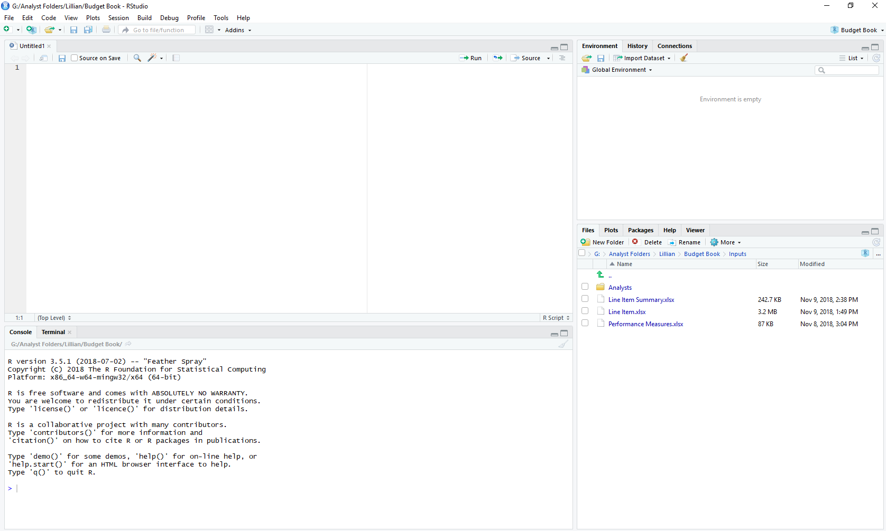
Intro to the RStudio interface
2
1
Scripts: View and manipulate scripts
Data: View data
2
Environment: View objects like data frames, vectors, etc.
History: View code you have executed
Connections: View connections to databases
1
3
4

Slide 9
Intro to the RStudio interface
2
3
Console: Execute code
Terminal: Access Windows command line or git bash
4
Files: Similar to Windows file explorer
Plots: View plots once generated
Packages: Install, uninstall, or update packages
Help: View documentation for functions or packages
Viewer: View local web content like that generated by Shiny
1
3
4
Install: tidyverse, rio, magrittr

Slide 10
A vocab lesson
Terms
Examples
Function: A verb
Base functions
Package functions
Custom functions: DNRY – do not repeat yourself!
Argument: An adverb
Required
Optional
Object: A noun
Function: toast()
Argument
toast(what = “bread”, how = “lightly”)
Object
meal <- toast(what = “bread”, how = “lightly”)

Slide 11
Questions?
Lillian Nguyen, Data Analytics Lead
Finance Department
Bureau of the Budget and Management Research
lillian.nguyen@baltimorecity.gov
443.984.3987
100 N. Holliday Street, Room 436

